Slide 1
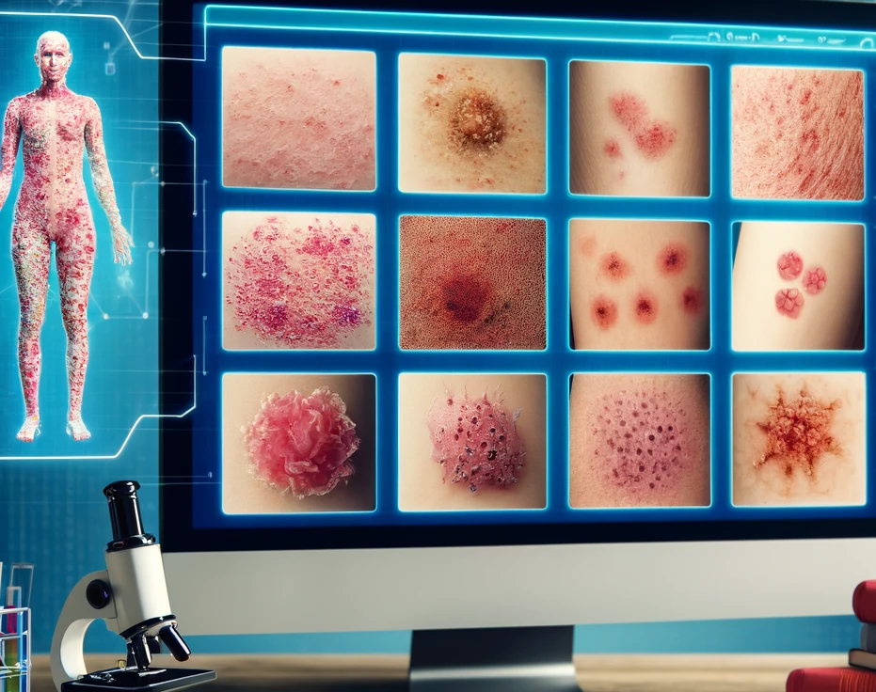
Generating Synthetic Medical Images: SkinRashGenerator With Finetuned CLIP & Latent Diffusion for improved results
Devesh Surve
Haonan Chen
24th April

Slide 2
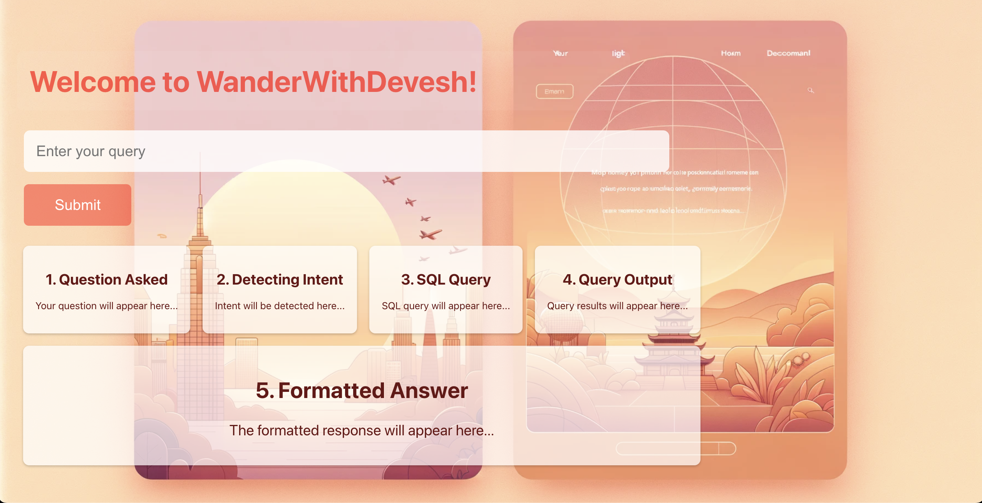
Project Overview
Objective:
Problem Statement:
Solution Overview:

Slide 3
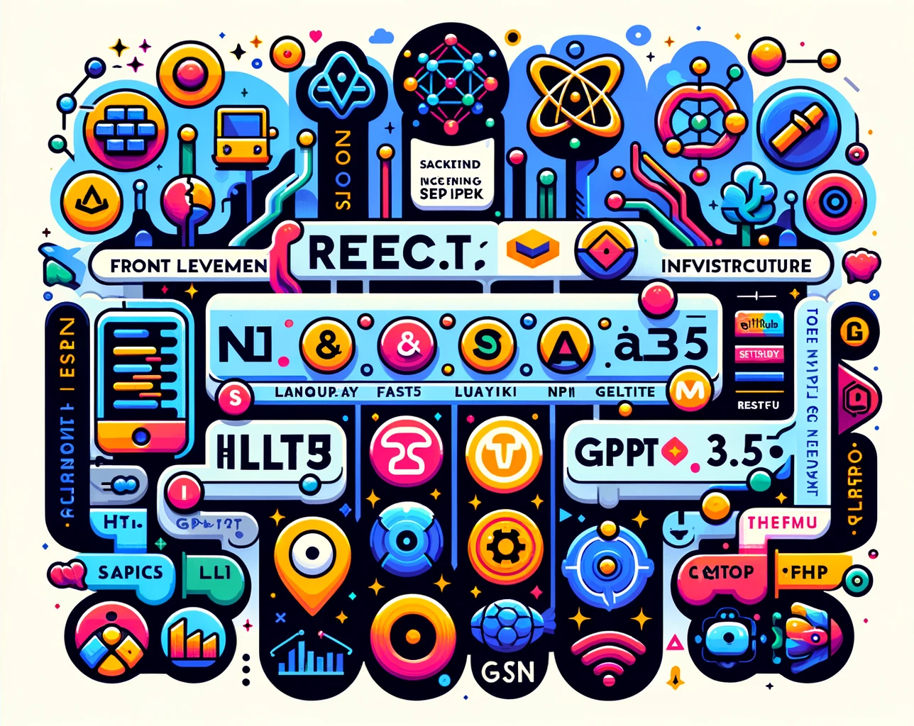
Technology Stack
Frontend Development:
Backend Infrastructure:
Generative AI for Images:

Slide 4
What is Latent Diffusion
Frontend Development:
Backend Infrastructure:
Generative AI for Images:

Slide 5
What is UNet
Defintion and technical details

Slide 6
What is VAE
Defintion and technical details

Slide 7
What is CLIP
Defintion and technical details

Slide 8
Implementing Latent Diffusion (Project Arch )
Tell about Kaggle notebook and other approach github

Slide 9
How does it work for our problem statement ( before finetuning )
Show examples of diff types of images being gneeratedf

Slide 10
Potential Solution – ( Finetuning CLIP )
Explain what does finetuning of LLMs mean
What is clip finetuning

Slide 11
Successful / Failed approaches
Talk about trial and errors

Slide 12
After Finetuning ( Results )
Show results ( either with prompt engg if this doesn’t work ) 27 images ( and how much every image improved )

Slide 13
Learnings
Tell about things learnt, finetuning, image generation etc

Slide 14
Future Improvements
Talk about different approaches

Slide 15

Conclusion and Future Work
Successfully developed a responsive and intelligent travel agent chatbot.
Leveraged cutting-edge technologies including React.js, FastAPI, spaCy, NLTK, and GPT-3.5.
Integrate and test against local-LLMs
Thank you Everyone for your attention and support !!

